Slide 1
Pay & Go
Abhipriti Sanjana V (av3021), Hubert Grillier (hg2594), Krithika Hunasehally Jayakumar (khj2113), Chaitanya Varma Kanumuri (ck3025)

Slide 2
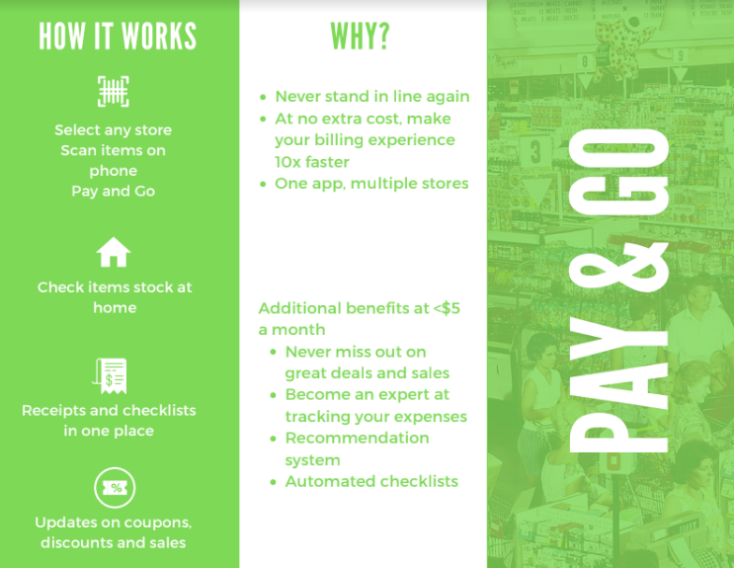

Slide 3
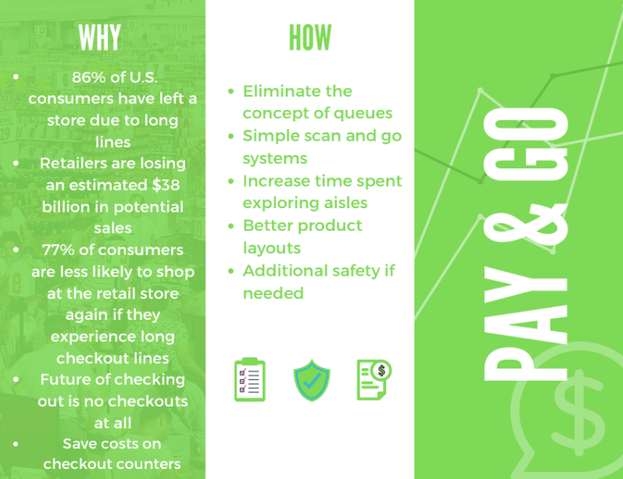

Slide 4
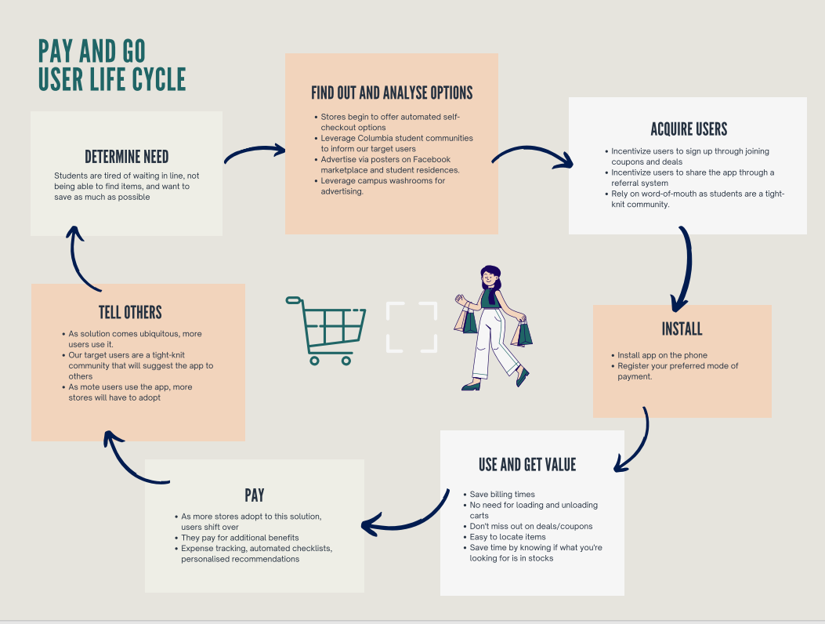

Slide 5
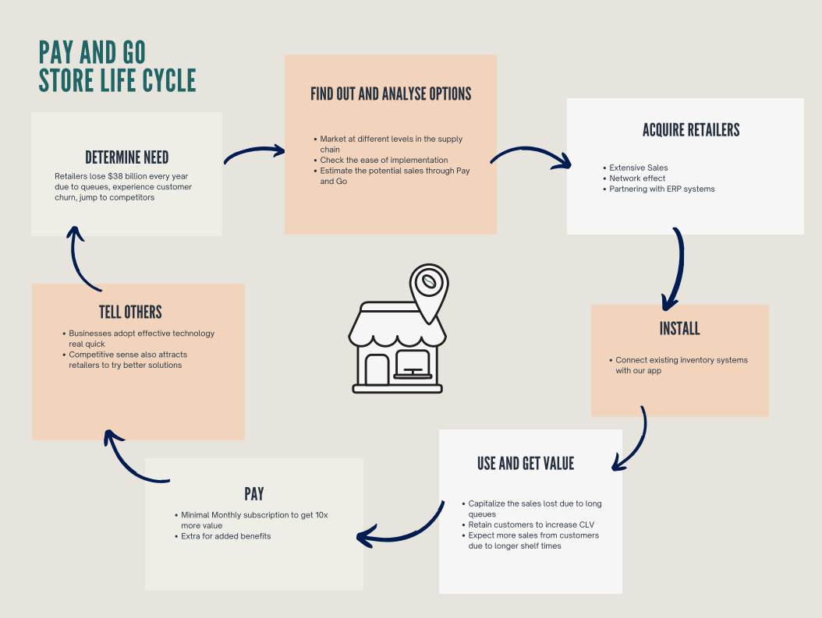

Slide 6
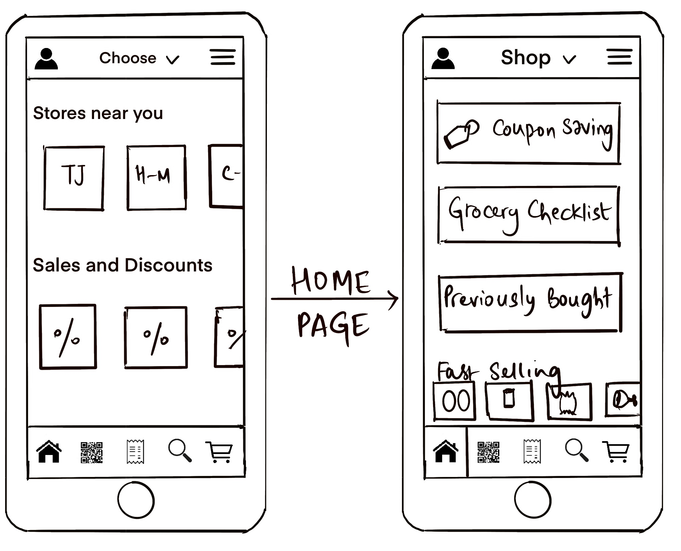
High level product specification

Slide 7
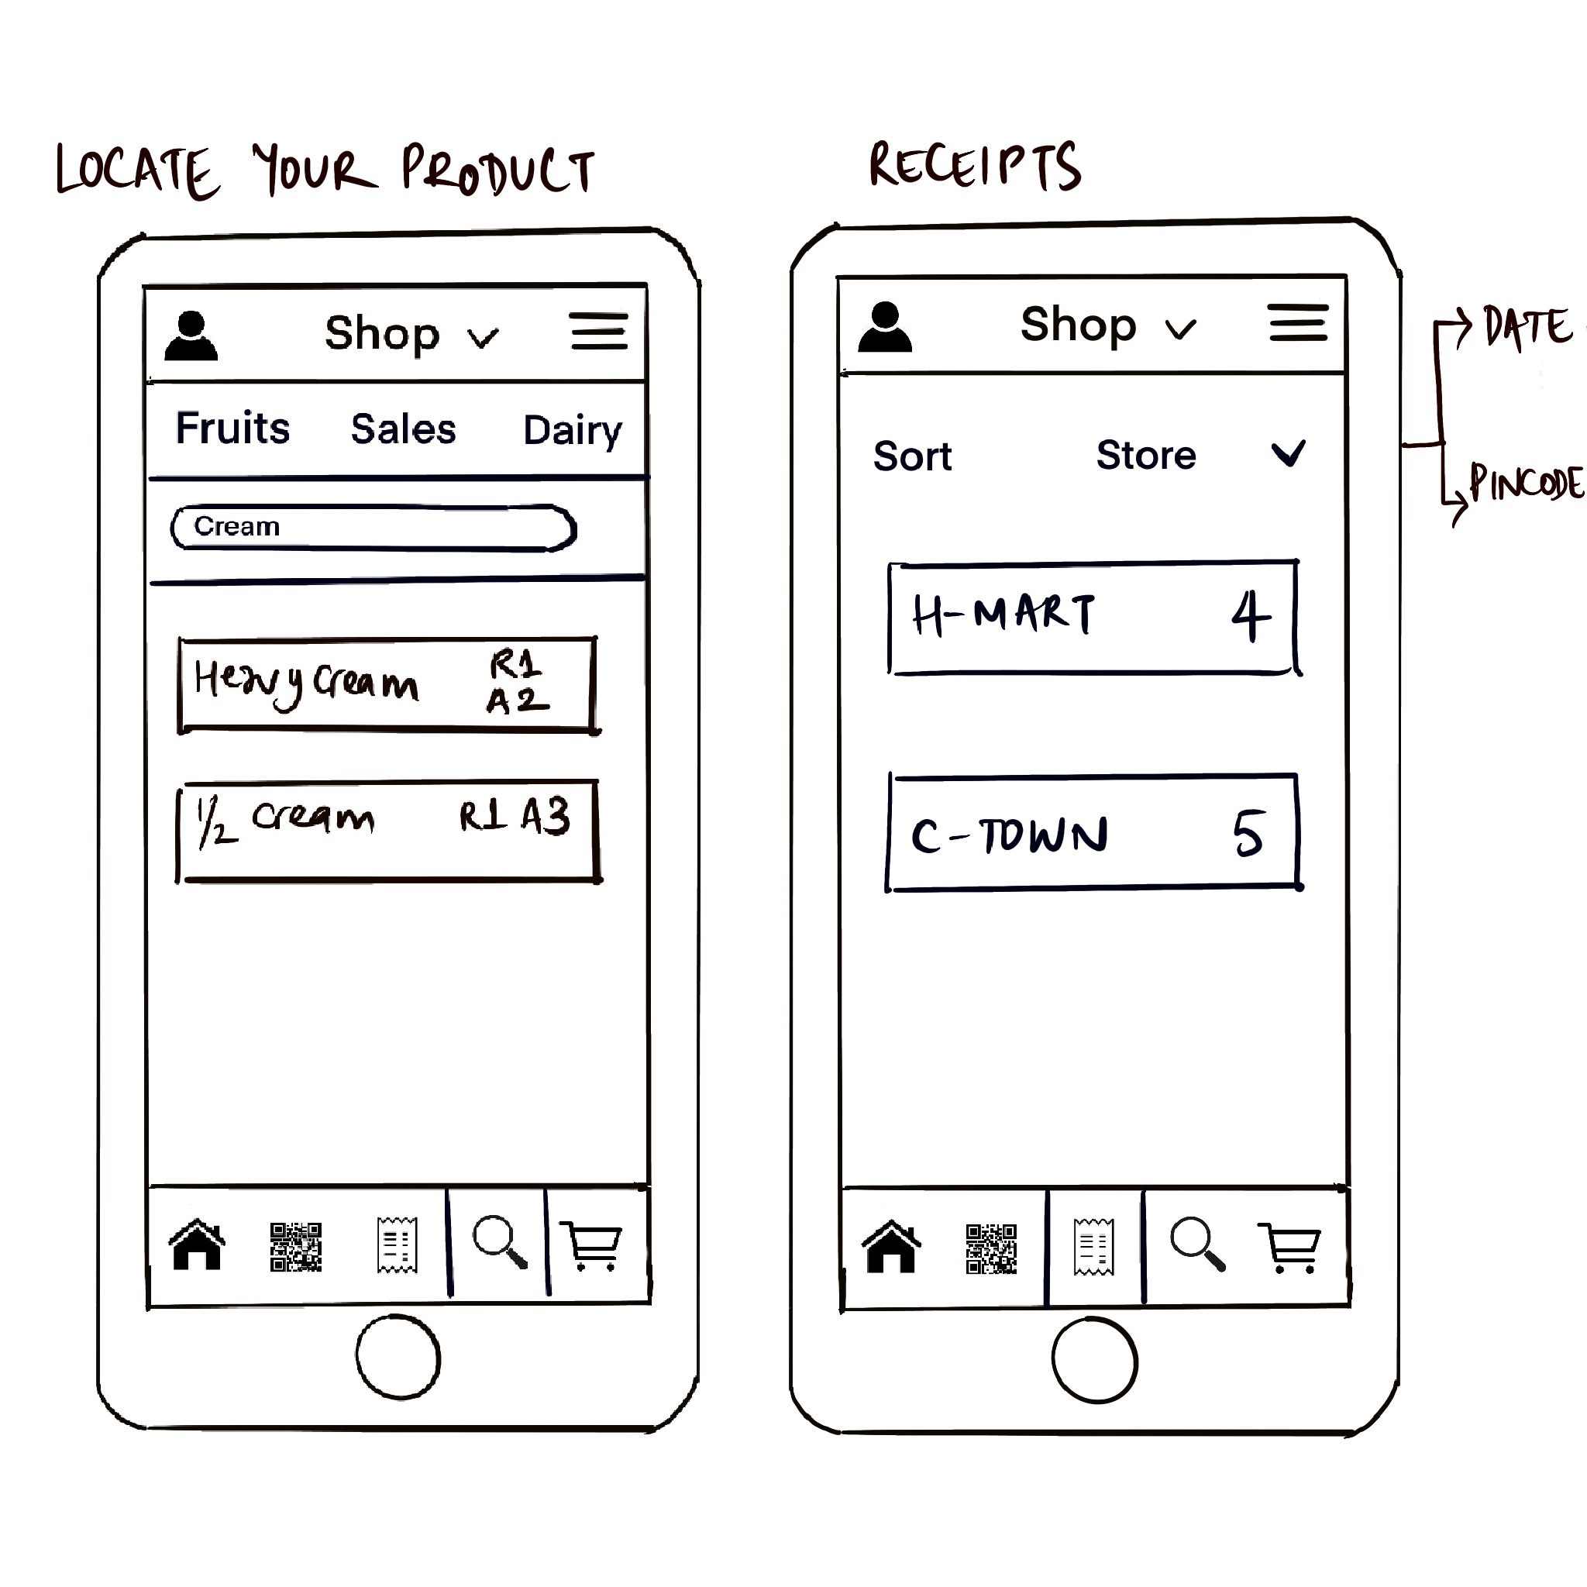

Slide 8
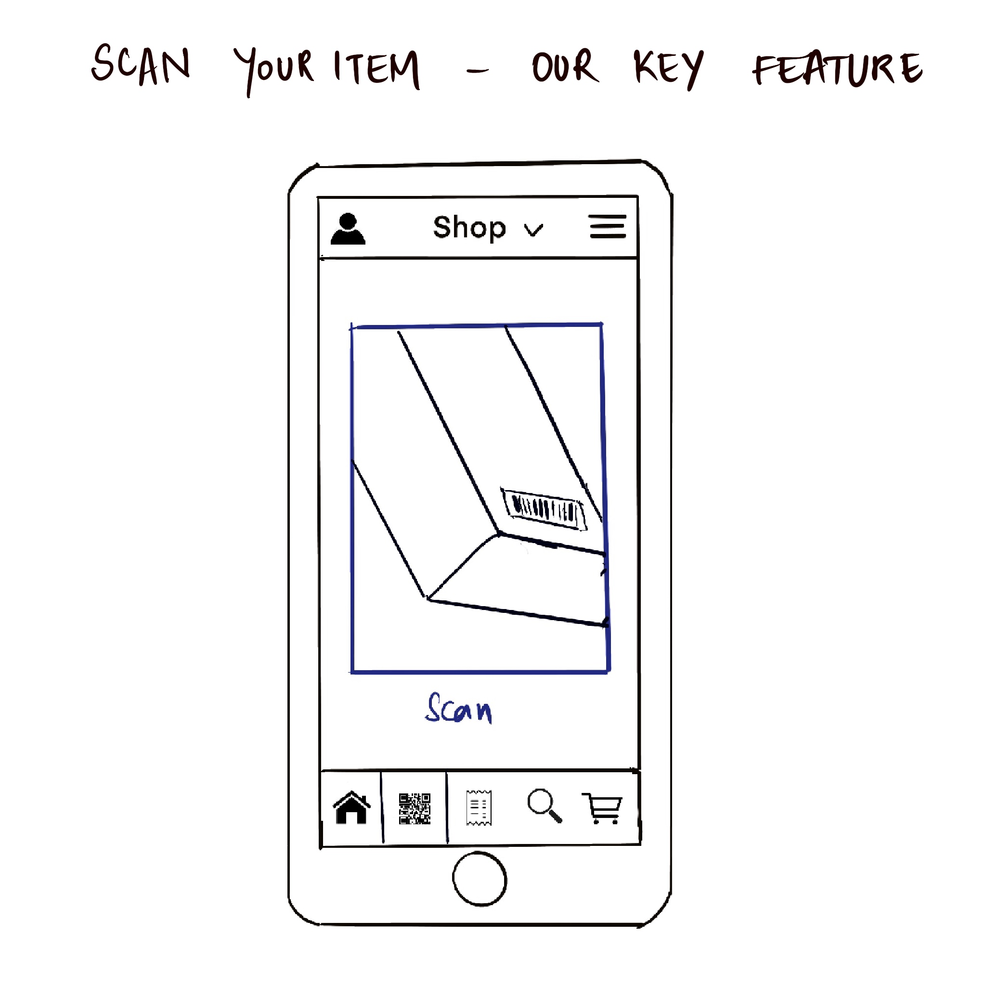

Slide 9
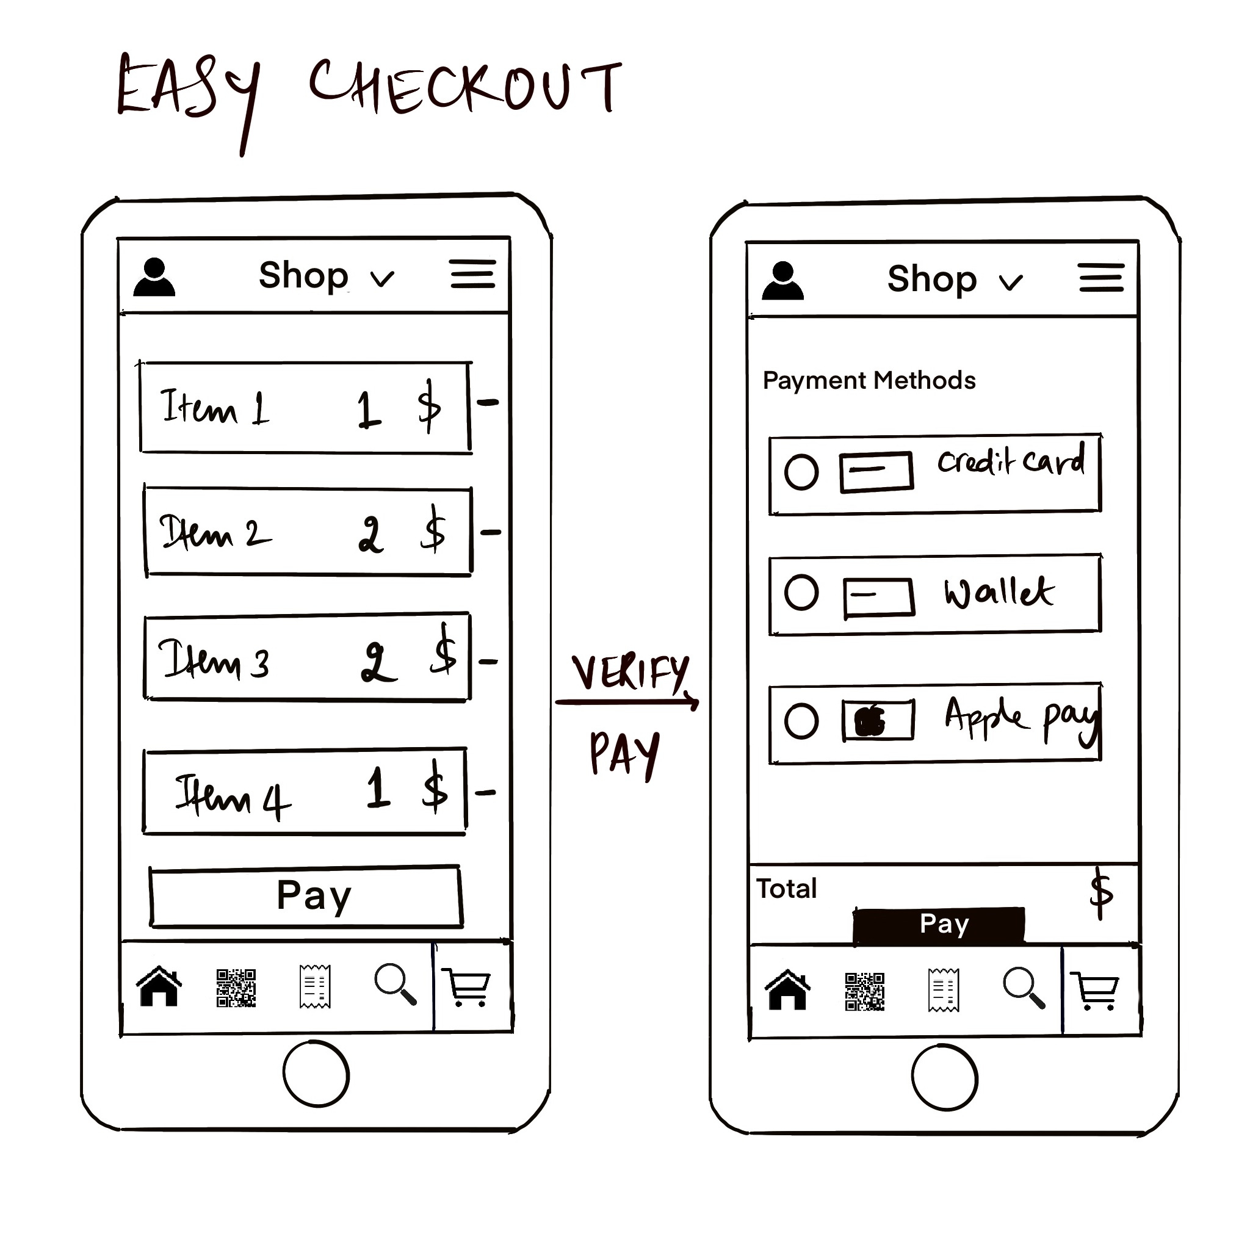

Slide 10





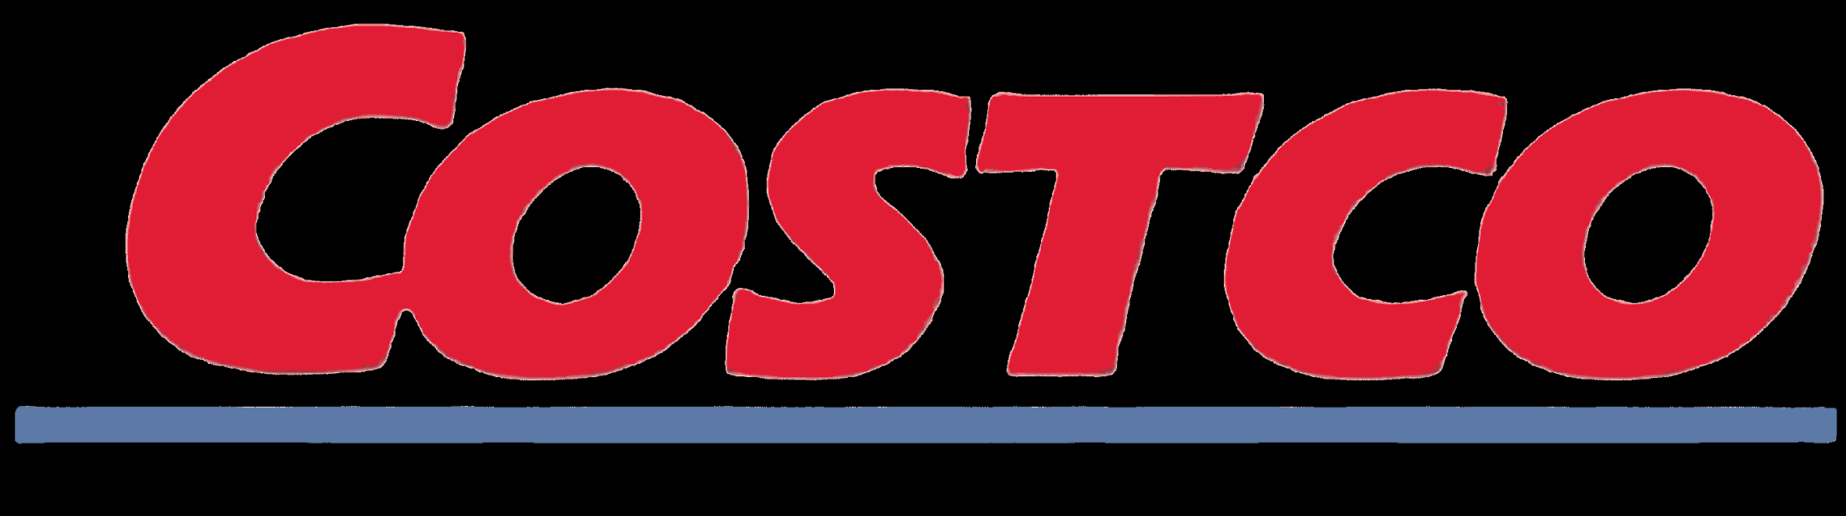
In-store shopping experience is here to stay, users and stores want to help improve experience and speed
Largest competitors currently fall under the following buckets:
Direct -
Traditional checkout and self-checkout counters manufacturers
Require large amounts of capital and space
Do not eliminate the need for queues
Major pain point is loading and unloading of their basket which is still present through these options
Targeted self billing solutions
Currently present for specific stores only
Indirect -
POS companies
Not a complete solution, and can be integrated with our platform
Online delivery services
Time and speed to delivery is a major factor
In-store shopping experience is important to our users
Customer Perception Map
Pay & Go
Speed
Customer experience
Market leaders, such as NCR manufacture self-checkout counters, however are capital intensive options. Amazon Go on the other hand lies in the exact space of the landscape we want to target, however is only for particular stores.

Slide 11






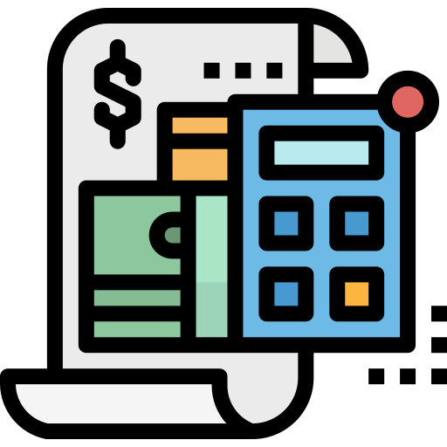
Pay & Go Value proposition for users
Pick Up Items
Stand in the checkout queue
Empty your basket
Scan your items
Pay
Load your basket again
Keep track of expenses
Not using Pay & Go
77 min
Using Pay & Go
24 min
Timeline (min)
0
20
0
10
0
5
0
5
0
2
0
5
0
30
-3
10
5
2
1
5
30
50 min
Time saved per week (min)
Key Value Proposition
Scan & bag items while picking them up, combining 3 steps into 1
Avoid queues at every possible checkpoint
Automatically sync data to an expense tracker and receive a personalized and detailed expense analysis

Slide 12


Pay & Go Value proposition for stores
High employee costs On average 4 to 6 employees for checkout counters → 15k per month → $180k per year
Lack of innovation Little to no tech usage in most of grocery stores → no way to attract new generation customers
Switching to Pay & Go
7
High switching costs to existing solutions Current self checkout solutions are capital intensive and also require large space which is not commonly available in major cities
Decrease costs Automatization of billing would reduce the need for employees at traditional checkout counters
Benefits up to $180k per month
Increase revenues Attract some new customers Increase the time they spend viewing products → potential gain up to $38 billions (across the US)
Improve operations Provide a real time store layout that allows customers to navigate aisles better, and improve product visibility for retailer.

